Slide 1
IT Recruitment
Symbol
Home
User ID
Password
Login
@ABC Company
Powered by : ISCOE

Slide 2
IT Recruitment
Symbol
Logout
Event
New
Modify
View
Interview
Student New
Modify
View
Evaluation
Approval
Reports
45
Events
100
Intern
10
Fulltime
Image Carousel
Powered by : ISCOE

Slide 3
Position List
-Intern (New)
-Intern (Return)
- Fulltime
IT Recruitment
Symbol
Home
Logout
Enter Student details
Enter position details
Event
New
Modify
View
Interview
Student New
Modify
View
Evaluation
Approval
Reports
Event Description (multiline)
This box will have more than one update for the same event details (based on the positions)
Positions (list*)
School
Approved Count
Tentative Count
Department
St. Date (Calendar)
Ed. Date
Skills
Password
Street
Specialization
State
ZIP
Job Start Date (Calendar)
TR Representative
BU Representative
Update
Student Representative
Clear
Save
Powered by : ISCOE

Slide 4
IT Recruitment
Symbol
Home
Logout
Select Event (List from DB)
Event
New
Modify
View
Interview
Student New
Modify
View
Evaluation
Approval
Reports
Enter Student details
Last Name
Skills
Middle
Specialization
(Informational/
Official)
First Name
Desired Position (list)
Mobile
Brass ring Reference ID
Email (Mandatory)
Interview Type List
Year of Study
Interviewer (list from DB)
Upload Resume
Clear
Save
Powered by : ISCOE

Slide 5
IT Recruitment
Symbol
Home
Logout
While loading the form get
the available events form
The server DB
Event
New
Modify
View
Interview
Student New
Modify
View
Evaluation
Approval
Reports
Select a event
Select Reports
User ID
Run Report
Select available reports
Password
Report output?
Powered by : ISCOE

Slide 6
Reference

Slide 7
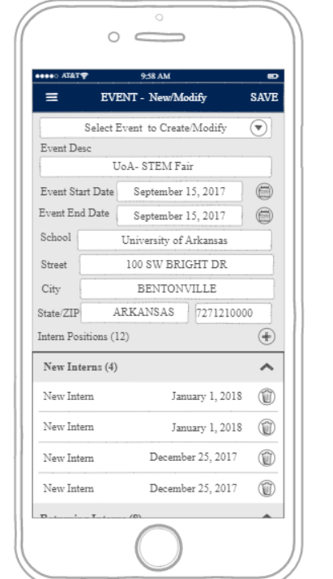
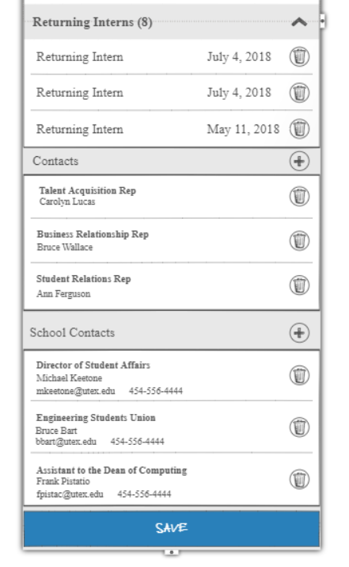
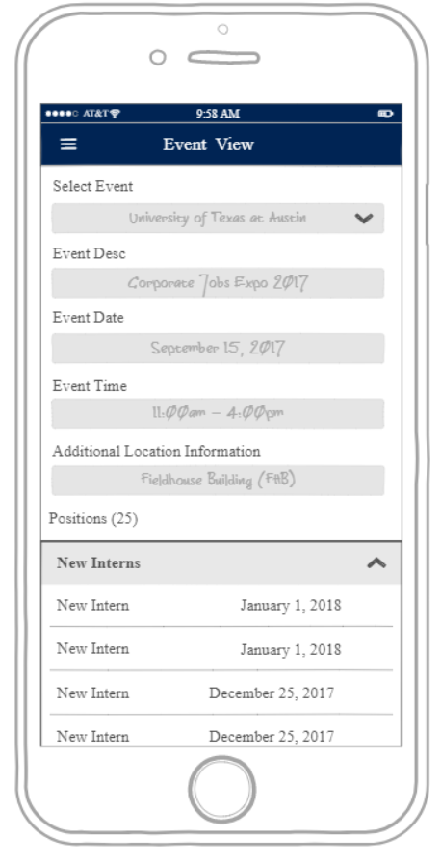
4
EVENT New/Modify
4
CREATE/EDIT CONT.
5
VIEW EVENT DETAIL
Select Event will have an option to create new
B
A
A
C
C
B
A
Edit Event Screen. Select school and fill out
the event details
C
Below the visible screen, the user will
have the ability to add TM Contacts and School contacts
A
View Event Detail Screen
B
Add the Positions and have the ability to view
and delete from this screen
Creating, Editing, and Viewing Events

Slide 8
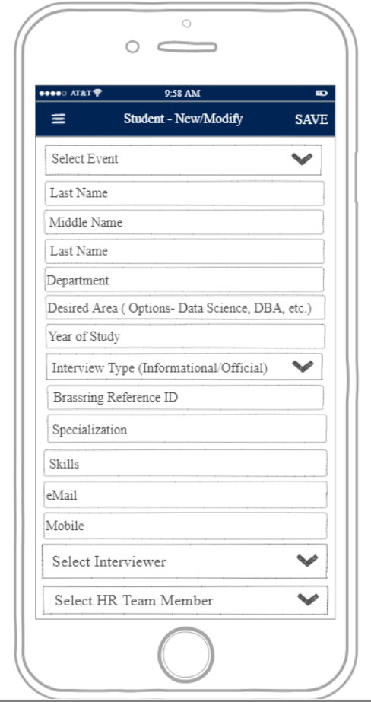
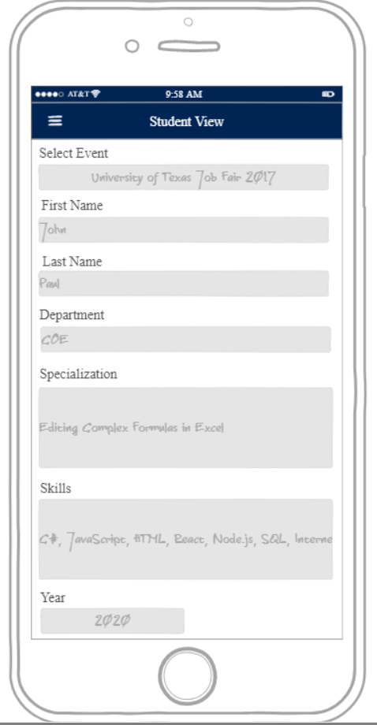
8
STUDENT – New/Modify
9
VIEW STUDENT
A
A
Added a field to capture (desired Area )
Create new Student Item by starting
to select the event
A
Viewing the Student item in its read
only state.
A
Adding and Viewing Students

Slide 9
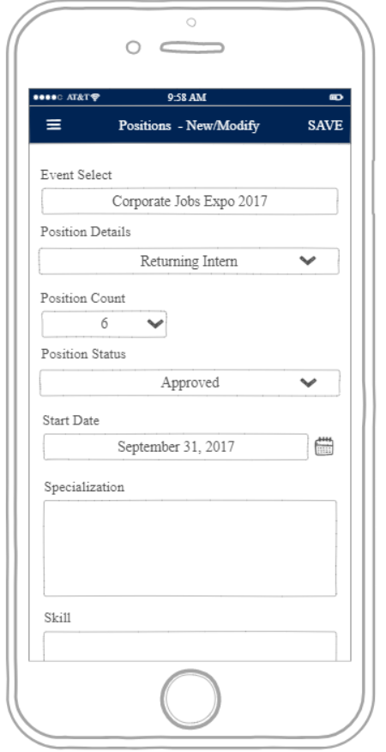
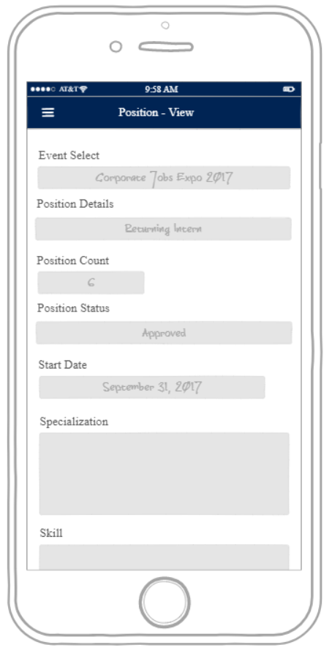
6
OPEN POSITION ENTRY/MODIFY
7
VIEW POSITION DETAIL
A
A
A
Adding a new position item related to
An event that was selected in screen
#3B
A
Viewing the Position item screen by tapping
On the item from screen #3B
B
Add the Positions and have the ability to view
and delete from this screen
Creating and Viewing Positions

Slide 10
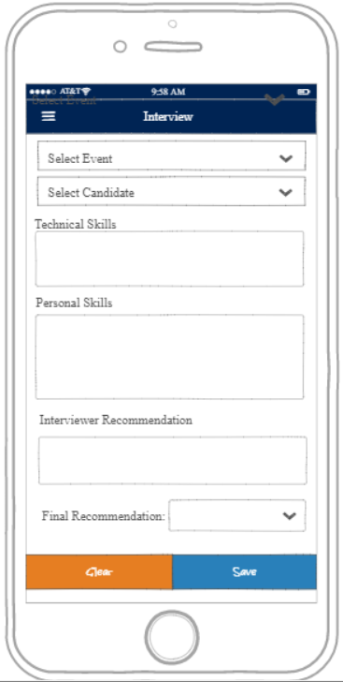
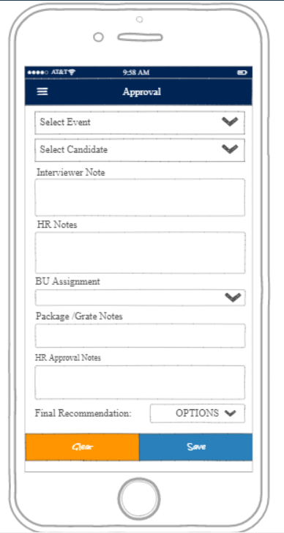
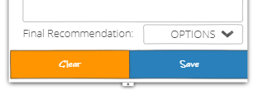
10
CANDIDATE ASSESSMENT
11
HR APPROVAL
A
A
B
B
C
C
A
Select the event to associate the
interview item.
A
Select the event to associate the interview
item.
B
Then choose the student.
B
Then choose the student.
C
(Not Shown) Provide the approval status.
C
Provide the approval status.
Interview and Approval

Slide 11
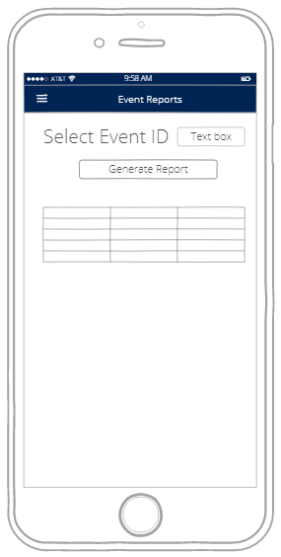

12
EVENT REPORT
13
INTERVIEW REPORT
Reporting

